Slide 1
DRAFT
THIS DECK IS STILL DRAFT

Slide 2
Presentation Notes
This entire deck, including demos but not the checkpoints, must be delivered in 10 minutes or less. Participants need time to do the actual lab.
Talking points are very brief. Even if you’ve seen the same slide in the past, take note of the new talking points.

Slide 3
Introduction to Windows 10 IoT Core
Code Labs

Slide 4

Disruptive Forces Enabling IoT
Moore’s Law
Metcalf‘s Law
Koomey’s Law
Transistors
Computations
per KWh
10,000,000,000
1.E+14
1,000,000,000
1.E+12
100,000,000
1.E+10
10,000,000
1.E+08
1,000,000
1.E+06
100,000
1.E+04
10,000
1.E+02
1,000
1.E+00
1970
1980
1990
2000
2010
1940
1975
2010
And more importantly:
what can you do by combining and analyzing signals from all of these IoT devices?
Notes:
“Moore’s law tells us that computers are still getting more powerful. Koomey’s law tells us that they also require a lot less power than they did in the past. And Metcalf’s law observes that computers are more valuable when they are more connected. All of these things apply directly to, and in fact enable, IoT.”
Reference:
The graphs are illustrations, not exact values
Moore's law is the observation that the number of transistors in a dense integrated circuit doubles approximately every two years.
Metcalfe's law states that the value of a telecommunications network is proportional to the square of the number of connected users of the system (n²).
Koomey’s law describes a long-term trend in the history of computing hardware. The number of computations per joule of energy dissipated has been doubling approximately every 1.57 years. This trend has been remarkably stable since the 1950s (R² of over 98%) and has actually been somewhat faster than Moore’s law. Jonathan Koomey articulated the trend as follows: "at a fixed computing load, the amount of battery you need will fall by a factor of two every year and a half."

Slide 5
IoT is gaining momentum
2010
Alarm clock
Refrigerator
Automobile
VoIP phone
Computer
Printer
Media player
Microwave
HOME
WORKPLACE
HOME
Coffee maker
Smart scale
Oven
Cell phone
HVAC
Vending
Security
Television
Notes:
“Back just a few years ago, the uses for IoT were pretty limited. Mostly smart embedded devices doing PC-like things, as well as many of the scenarios carried over from decades of embedded computing.”

Slide 6
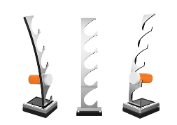
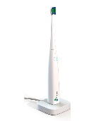
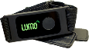
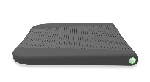
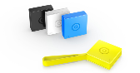
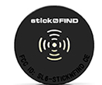


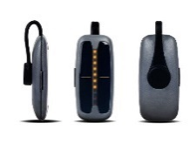
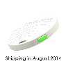
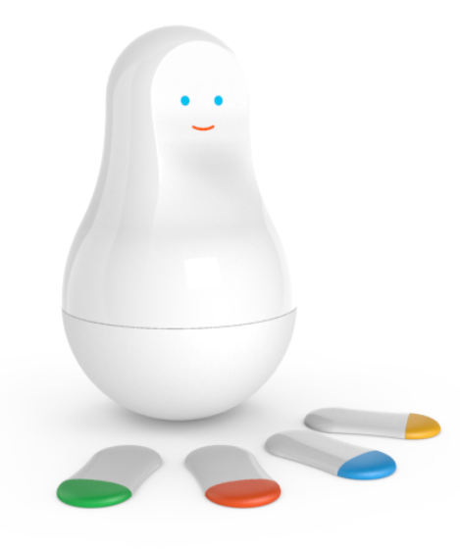
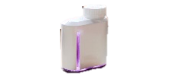

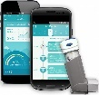
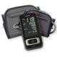


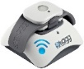
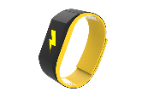

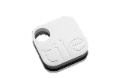
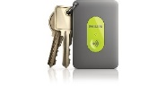
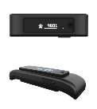
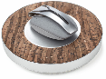

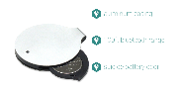
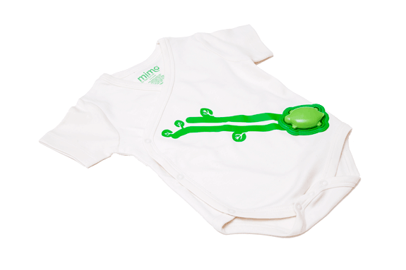
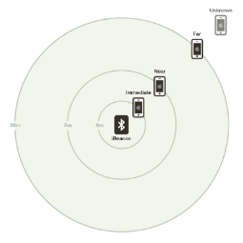
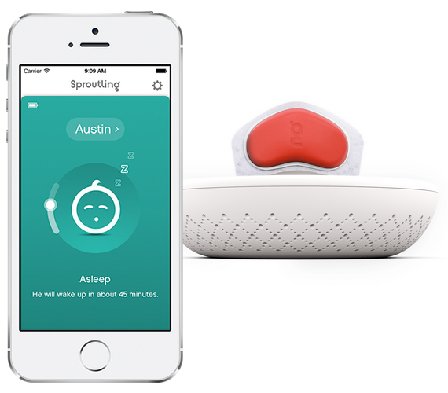

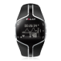
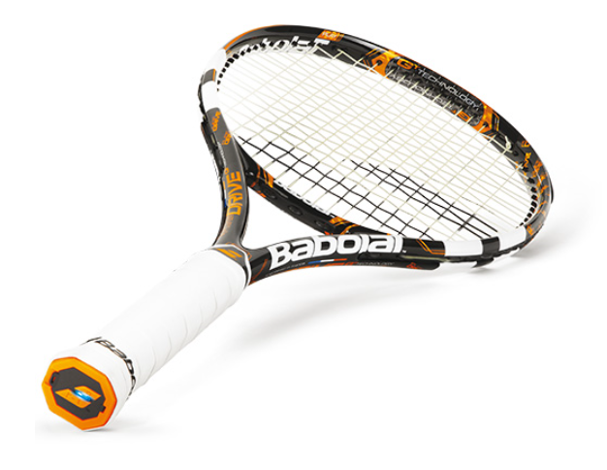
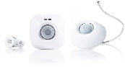
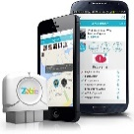
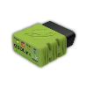
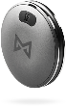
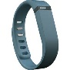

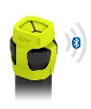
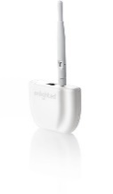



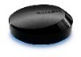
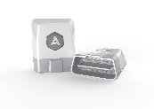
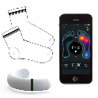
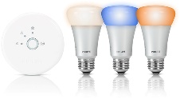
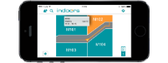
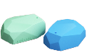
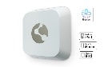
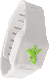
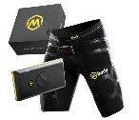
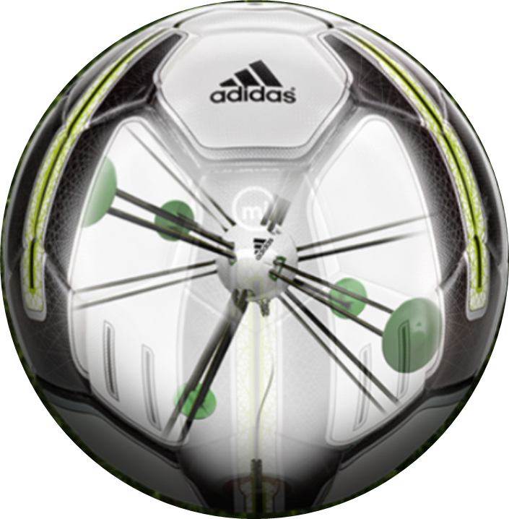
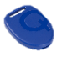

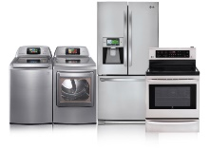

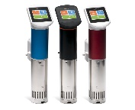
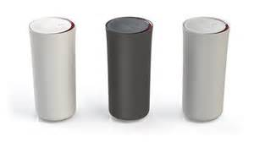
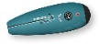
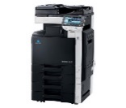
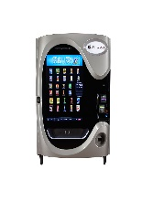
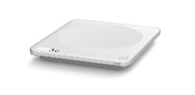
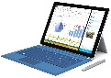







































Medication adherence
Health monitoring
Pet tracking
Behavior modification
Object tracking
Child and elder monitoring
Sports and fitness
Indoor navigation
Trip tracking and car health
Smart lighting
Beacons and proximity
COMMUTE
COMMUTE
HOME
WORKPLACE
HOME
Smart appliances
Food and nutrition tracking
Identity
Office equipment
Smart vending machines
Bike ride stats and protection
Air conditioning and temperature control
Sleep tracking
Environmental sensors
Information capture
Control
Home security
Home automation
Leak detection
Garden, lawn and plant care
New devices and sensors
Entertainment systems
Notes:
“But today, we’re seeing IoT everywhere, with devices that are smarter because they are both more powerful and more connected.”

Slide 7
IoT is an Inflection Point
Hardware
is cheap
Connectivity
is pervasive
Development
is easier
New Innovative Scenarios
Huge benefits
fuel demands
Notes:
“Today, you can buy a very powerful device for $35 or less, connect it to services like Azure, develop for it using commercial-grade tools like Visual Studio, and save your company, or your clients, a ton of money due to the intelligence gained and automation performed.”

Slide 8
Windows 10 IoT Core
Notes:
So let’s take a look at our free client operating system that addresses part of this category: Windows 10 IoT Core

Slide 9













Windows on a full range of devices…
2-in-1s (Tablet or Laptop)
Classic Laptop
Desktops & All-in-Ones
Phone
Phablet
Small Tablet
Large Tablet
Windows 10
Surface Hub
Xbox
Holographic
IoT
Notes:
“With Windows 10, we’ve taken our best work from Desktop, Windows Phone, and Xbox merged it into a single core operating system with a tailored experience for each device. Windows 10 runs on everything from Phone to laptop to desktop to IoT devices and Hololens.”

Slide 10
...with a consistent programming model
Windows Universal Platform
Common & Consistent APIs
Languages
C++ /CX
C#, VB
JS
Wiring
Python
Node.js
others
UI Frameworks
HTML
Xaml
DirectX
APIs
WinRT
Win32
.NET
Wiring
others
Deployment and Execution
APPX
Xcopy
App Isolation
Notes:
“For developers, the most exciting part of unifying Windows is the Universal Windows Platform (UWP) programming model. UWP defines a full set of APIs supported by languages including C++, C#/VB, and JavaScript. Additionally, for IoT apps and more, we’ve added support for Wiring, Python, and Node.js
The apps you write are not just source compatible, but are binary compatible (within processor family) across devices.”

Slide 11

…on some pretty cool IoT devices
Notes:
“Windows 10 for IoT is officially available on three families of boards:
Raspberry Pi 2 and 3
Minnowboard Max (essentially the guts of a tablet)
Dragonboard (essentially the guts of a phone)
Additionally, companies like Toradex have ported Windows 10 IoT Core to modules running other processors, like the Nvidia Tegra 3.
Part of UWP is our programming model for IoT. When targeting these devices with Windows 10 IoT Core, you get low-level access to GPIO, PWM, SPI, I2C, and more.”

Slide 12

Windows 10 IoT Core
App owns the whole user interface. Optimized for embedded use.
Deployment and debugging in Visual Studio.
Development-time management through web site, PowerShell, SSH, and more.
Notes:
“Our free version of Windows 10 for small IoT Devices is called Windows 10 IoT Core. IoT Core is Windows, but without the desktop and shell components. Instead, your app owns the user interface and experience.
Windows 10 IoT Core runs a single foreground app at a time, however, you can create long-running background tasks which run concurrently with your app.”

Slide 13
Continuum of Making
Tinkerer
Education
Hobbyist
Prototyper
(personal, Enterprise, etc.)
Small Scale Production / Crowd Funding
Large Scale Production/ Enterprise
A continuum rather than distinct points on a journey, makers span the entire process from learning to production. Each have different product and support needs.
Notes:
(This is to answer the “why” of IoT core and of makers in general)
“Microsoft views making as a continuum, starting from tinkerers and education through to hobbyists, pre-production, prototyping, production, and more. It’s not just about a student in school, but also about the person prototyping the next cool product at a fortune 500. Windows 10 IoT Core has been designed for all of these makers.”

Slide 14

Lab Setup
Direct wired Ethernet for Deploy/Debug
WiFi for Azure (Lab 3)
Development PC
Raspberry Pi 3 with FEZ HAT
Notes:
“At each of your stations is a Raspberry Pi 3, hard-wired to the development PC. This is for deployment and debugging. The WiFi connection from the Pi 3 is for connection to Azure in follow-on lab modules.”

Slide 15
GHI FEZ HAT
On-Board Analog Input and PWM chips.
Two DC Motor Drivers, suitable for building small robots.
Terminal Blocks for wiring in DC motors without the need for soldering.
Two Servo Motor Connections + Servo power.
Two Multi Color LEDs, connected to PWM for thousands of colors. Single Red LED.
Temperature and Light sensors
Accelerometer.
more
Notes:
“Because most of you will also participate in the Azure parts of this series, we’re using an integrated sensor HAT-like (Hardware Attached on Top) board from GHI
This board was developed especially for Azure labs and simplifies connectivity to sensors in a way that lets you focus on Azure. It includes libraries which abstract away the underlying IO, much like you would have if you coded for a shield on an Arduino.”

Slide 16
IoT Lab Modules
1
Learn about Windows 10 IoT Core on the Raspberry Pi 3
2
Learn about Microsoft Azure IoT without using a device
(concurrent with Module 3)
3
Learn how to connect Windows 10 IoT Core with Microsoft Azure
(concurrent with Module 2)
4
Concurrent Open Hack
(days 2 and 3)
Notes:
“As a follow-on to this lab, we also have the Azure IoT lab. In that, you’ll learn how to use the Raspberry Pi to send sensor data to IoT Hub and process it using other Azure IoT services.
If you are interested in the underlying IO and other capabilities on devices like the Raspberry Pi, or want to explore more with Azure and devices, we also have the Open Hack in this same room, starting on Day 2.”

Slide 17
IoT Dev Code Lab Related Sessions Wednesday 03/30
11:30 – 12:30 |  | IoT Lab Module 1 Here | Windows 10 IoT Core and Azure IoT Suite QSC Garage
14:00 – 15:00 |  | IoT Lab Modules 2 + 3 Here | Windows 10 IoT Core and Azure IoT Suite QSC Garage
15:30 – 16:30 | IoT: Microsoft’s IoT Vision and Roadmap Marriott 7 | IoT Lab Module 1 Here | Windows 10 IoT Core and Azure IoT Suite QSC Garage
17:00 – 18:00 |  | IoT Lab Modules 2 + 3 Here | Windows 10 IoT Core and Azure IoT Suite QSC Garage

Slide 18
IoT Dev Code Lab Related Sessions Thursday 03/31
11:30 – 12:30 |  | IoT Module 1 Open Hack! Here | Windows 10 IoT Core and Azure IoT Suite QSC Garage
14:00 – 15:00 |  | IoT Lab Modules 2 + 3 Open Hack! Here | Windows 10 IoT Core and Azure IoT Suite QSC Garage
15:30 – 16:30 | Azure IoT: Product, Vision & Roadmap Marriott 8 | IoT Module 1 Open Hack! Here | Windows 10 IoT Core and Azure IoT Suite QSC Garage
17:00 – 18:00 |  | IoT Lab Modules 2 + 3 Open Hack! Here | Windows 10 IoT Core and Azure IoT Suite QSC Garage
18:30 – 19:30 | Developer’s Guide to Connecting Devices to Azure IoT Marriott 8 | IoT Module 1 Open Hack! Here | Windows 10 IoT Core and Azure IoT Suite QSC Garage

Slide 19
IoT Dev Code Lab Related Sessions Friday 04/01
09:00 – 10:00 | Windows 10 IoT Core: From Maker to Market Marriott 7 | IoT Module 1 Open Hack! Here | Windows 10 IoT Core and Azure IoT Suite QSC Garage
10:30 – 11:30 |  | IoT Lab Modules 2 + 3 Open Hack! Here | Windows 10 IoT Core and Azure IoT Suite QSC Garage
12:30 – 13:30 |  | IoT Module 1 Open Hack! Here | Windows 10 IoT Core and Azure IoT Suite QSC Garage
14:00 – 15:00 |  | IoT Lab Modules 2 + 3 Open Hack! Here | Windows 10 IoT Core and Azure IoT Suite QSC Garage

Slide 20
Lab
Share your photos and experiences!
#Build2016
Notes:
You should get to this slide no later than 10 minutes into the session
Show how to get to the lab on the workstation, and then leave this slide up on the projector.

Slide 21
Checkpoint 1
Set up WiFi (May already be set up) and used the Web Management Portal?
Any problems deploying the Hello World app?
Notes:
20 minutes into the session (10 minutes after end of presentation)
If it looks like more than a few people are having problems, do a deploy from the podium. Anyone interested can watch

Slide 22
Checkpoint 2
Blinked the LED using Windows.Devices.Gpio
Blinked the LED using the FEZ HAT driver code
Notes:
40 minutes into the session (half hour after the presentation ends)

Slide 23
Wrap-Up
Please clean up around your workstation
Return all additional components and materials to the table.
Unless you are staying through to the next session, please log out of the PC
Come back for open hack on days 2 + 3!
Notes:
End of session
“Thanks everyone! I hope you were able to make it through all of the exercises. If not, feel free to hang around for a bit to keep working during the break. You’re also welcome to come back again and repeat the lab.
If you really want to tinker and experiment, come back to the Open Hack. Space permitting, this runs during all sessions on days 2 and 3.”

